Slide 1

Day 39 – Calculus in Data Science (Part 2)¶
What We Did So Far (Quick Recap)
In Day 38, we learned:
Why calculus is needed in Data Science
What derivatives mean
What integrals represent
How calculus helps in optimization
Today, we will:
Strengthen intuition
Connect calculus to ML
Work with multiple variables
Visualize concepts

Slide 2
Why Calculus in datascience Is Important¶
We often ask: "How calculas is used in ML"
Today answers:
WHERE calculus is used
WHY ML needs calculus
HOW complexity increases in real models

Slide 3
What is a Derivative?
Derivative means:
How fast something is changing.
Examples:
• Speed = Change in distance / time
• Profit change
• Temperature change

Slide 4
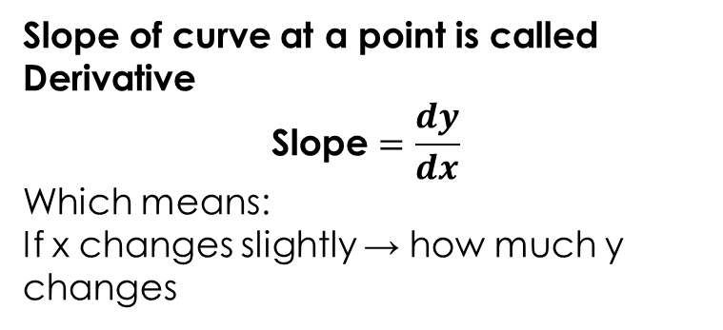
Derivative = Slope of Curve in machine learning
Slope of curve at a point is called Derivative
$$\text{Slope}=\frac{dy}{dx}$$
Which means:
If x changes slightly → how much y changes
For a curve:
Slope keeps changing.
Mathematically:
dy/dx
What is Slope of a Curve?
Slope of a curve means:
How steep the curve is at a particular point
- For a straight line, slope is constant. - For a curve, slope keeps changing at every point.
- So we measure slope at one specific point using a tangent line.

Slide 5
Basic Rules Of Derivatives
Power Rule:
xⁿ → n·xⁿ⁻¹
Examples:
x² → 2x
x³ → 3x²
5x⁴ → 20x³
Constant → 0

Slide 6
Simple Example with some slops
Suppose If:
y = x²
Now the question is if X changes how fast does y changes
Derivative:
dy/dx = 2x
If x = 3 → slope = 6
Meaning:
At x = 3 → curve is increasing with steepness 6

Slide 7
Point to remember Why this is Important in Data Science?
Used for:
• Machine Learning
• Model Optimization
• Neural Networks
Goal: Minimize Error
Example:
In ML :
Error = (Actual − Predicted)²
We take derivative of data points to reduce error.

Slide 8

What is Partial Derivative?
Normal derivative = one variable Partial derivative = multiple variables
Used when function has multiple variables.
Example:
z = f(x, y)
So We measure change with respect to:
x only
y only
Symbols:
$$\frac{∂z}{∂x}$$
$$\frac{∂z}{∂y}$$

Slide 9
Partial Derivative Example
z = x² + y³ (2 variable input features at a time )
So keeping one term constant we find the change in other
∂z/∂x = 2x (treat y constant)
∂z/∂y = 3y² (treat x constant)

Slide 10
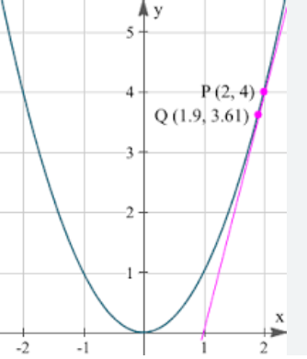
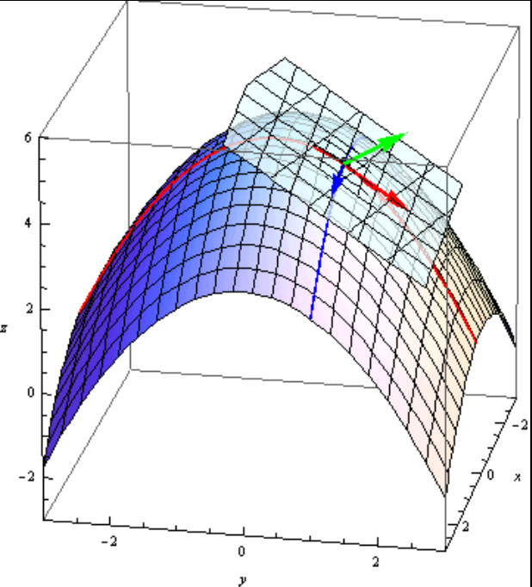
Visual Understanding (3D Surface)
Derivative = slope in 2D
Partial derivative = slope in 3D direction

Slide 11
Machine Learning Connection – Derivatives often connected with Loss functions
Loss Function: How wrong your model’s prediction is compared to the actual value . Indirectly it measures how incorrect the model prediction is .
Loss = (Actual − Predicted)²
We take derivatives to update model weights.
This is how models learn.
Derivative:
Rate of change of single variable function
Partial Derivative:
Rate of change of multivariable function w.r.t one variable

Slide 12
Practice Questions
Mixed Homework — Derivatives & Partial Derivatives
Find the derivative: f(x) = 3x²
Find the derivative: y = 5x³ + 2x
Find the derivative: y = 6x⁴ − 3x² + 7
Find partial derivatives: z = x² + y². Find ∂z/∂x and ∂z/∂y
Find partial derivatives: z = 3x² + 4y
Find partial derivatives: z = 5xy
Find partial derivatives: z = x²y + y³

